Slide 1

A Primer to Complex Diseases
National Institute of Technology Karnataka, Surathkal
A seminar by
Venkatesh. S (Roll No.:176PH023)
2nd M.Sc. Physics
(As part of seminar course PH893 during Odd Semester, 2018)
Notes:
Intro slide

Slide 2
Contents
What is a Complex disease?
How to study Complex diseases?
What can we aim to study with Complex Networks?

Slide 3
1. What is a Complex Disease?

Slide 4
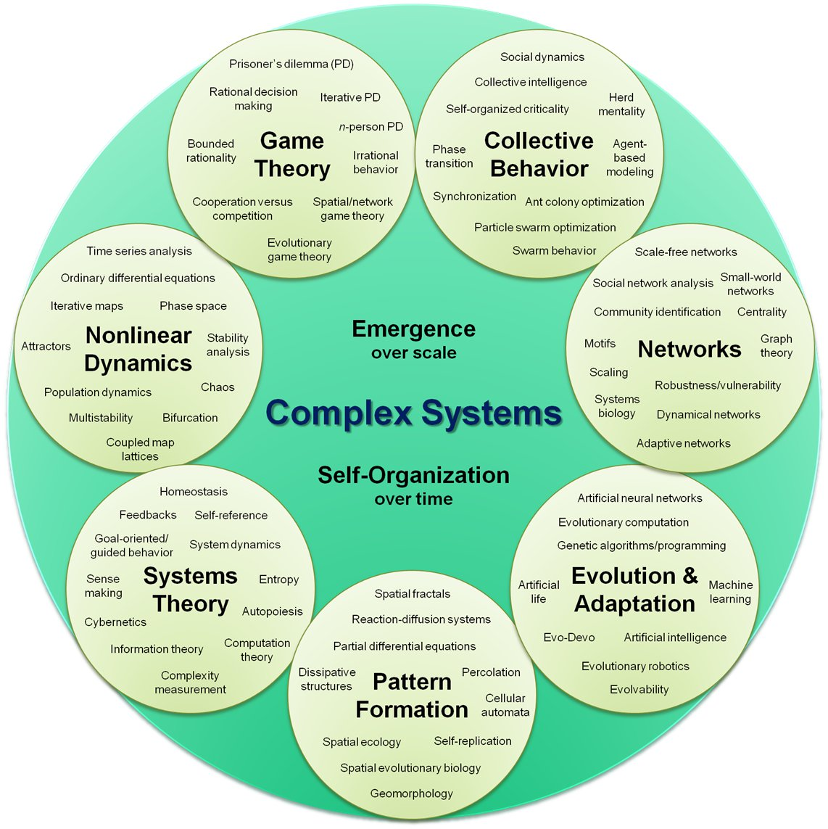
What is a Complex System?
“Complex systems are networks made of a number of components that interact with each other, typically in a nonlinear fashion. Complex systems may arise and evolve through self-organization, such that they are neither completely regular nor completely random, permitting the development of emergent behaviour at macroscopic scales.”^{1*}
*Not a definition. That would be reductionist!
1,2.
Fig 1. Concept map of Complex systems²

Slide 5
General properties of Complex systems
They have a large number of agents that can be considered simple.
Like ant colonies
The interactions are non linear
The whole is not the sum of the parts.
They show emergent behaviour.
There is a hierarchical organization.
They are self organizing.
No agent is the leader
They can be modelled as networks.
More on this later

Slide 6
What is a Complex Disease?
It is a type of complex system.
“…complex diseases [are those that] arise as a consequence of the combined effect of multiple genetic determinants, which may vary between individuals, and environmental factors and wherein the phenotype cannot be easily predicted from the genotype. This is proposed to be due to the interaction between genes (epistasis), modulation by environmental factors or stochastic processes, or epigenetic changes.”³

Slide 7
Complex diseases as Complex Systems
Agents – Thousands of Genes or Proteins or Metabolites
These genes or proteins interact chemically or physically, non linearly.
From the Central Dogma of Molecular Biology, we know that, mutations in the DNA sequence affect the genes which affects RNA which in turn affects the protein which in turn causes a phenotype(symptoms of the disease). Thus there is emergent behaviour(Hierarchical structure).
There is no one central gene that causes the disease. It is the result of complex interaction between multiple genes. Thus it is self organizing.

Slide 8
So, what is a Complex disease? A type of Complex system with thousands of genes/proteins/metabolites interacting non linearly causing an undesirable phenotype.
Any questions at this point? Please feel free to ask.

Slide 9
2. How to study Complex Diseases?

Slide 10
A general statement of the problem
We need to study the structure of the interaction between thousands of genes/proteins/metabolites.
It is logical to say that these interactions should not be random. Nature should have OPTIMIZED for something. For instance, for robustness or minimal number of agents in a particular reaction.
So, the general problem – How can several agents undergo interactions to get structured in a way to OPTIMIZE for something?
Have we encountered such a problem in other contexts? – YES!

Slide 11
A Physics problem – The Ising model

